Slide 1
RNN, LSTM, GRU

Slide 2
목차
Recurrent Neural Network
Vanishing Gradient Problem in RNN
Long Short Term Memory
Gated Recurrent Unit

Slide 3














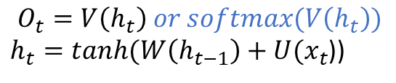






Recurrent Neural Network
RNN의 기본적인 구조
$$O_{t}=V\left(h_{t}\right) or softmax(V\left(h_{t}\right))$$
$h_{t}=tanh⁡(W\left(h_{t−1}\right)+U(x_{t}$))
$$o_{t}$$
$$o_{t−2}$$
$$o_{t−1}$$
$$o_{t}$$
$$V$$
$$V$$
$$V$$
$$h_{t}$$
$$h_{t−2}$$
$$W$$
$$h_{t−1}$$
$$W$$
$$h_{t}$$
$$U$$
$$U$$
$$U$$
$$x_{t}$$
$$x_{t−2}$$
$$x_{t−1}$$
$$x_{t}$$
One-to-One : Vanilla RNN
One-to-Many : Image Captioning
Many-to-One : Sentimental Analysis
Many-to-Many : Translation

Slide 4









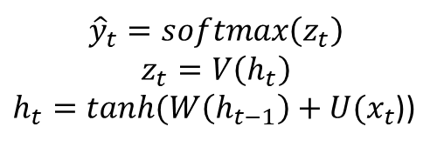












Vanishing Gradient Problem in RNN
Loss Back Propagation
$${\hat{y}}_{1}$$
$${\hat{y}}_{2}$$
$${\hat{y}}_{3}$$
$$softmax$$
$$z_{1}$$
$$z_{2}$$
$$z_{3}$$
$${\hat{y}}_{t}=softmax\left(z_{t}\right)$$
$$z_{t}=V\left(h_{t}\right)$$
$h_{t}=tanh⁡(W\left(h_{t−1}\right)+U(x_{t}$))
$$V$$
$$V$$
$$V$$
$$h_{1}$$
$$W$$
$$h_{2}$$
$$W$$
$$h_{3}$$
$$U$$
$$U$$
$$U$$
$$x_{1}$$
$$x_{2}$$
$$x_{3}$$

Slide 5








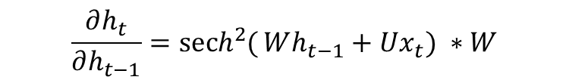





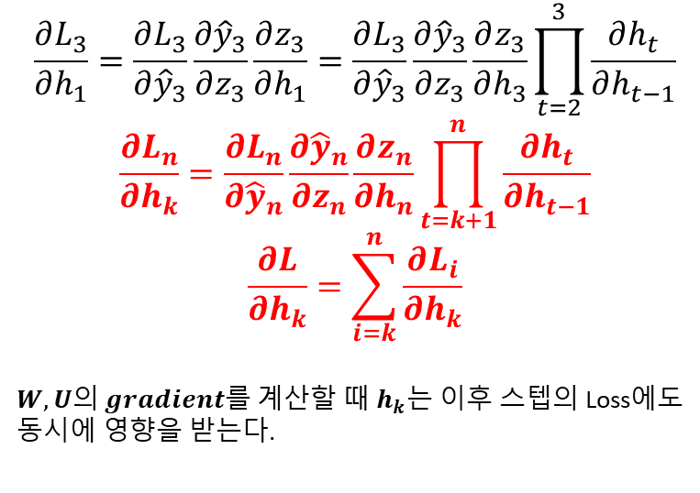



Vanishing Gradient Problem in RNN
Loss Back Propagation
$${\hat{y}}_{3}$$
$$Cross Entropy L_{3}=−y_{3}log{\hat{y}}_{3}$$
$$softmax$$
$$z_{3}$$
$$\frac{∂L_{3}}{∂h_{1}}=\frac{∂L_{3}}{∂{\hat{y}}_{3}}\frac{∂{\hat{y}}_{3}}{∂z_{3}}\frac{∂z_{3}}{∂h_{1}}=\frac{∂L_{3}}{∂{\hat{y}}_{3}}\frac{∂{\hat{y}}_{3}}{∂z_{3}}\frac{∂z_{3}}{∂h_{3}}\prod_{t=2}^{3}{\frac{∂h_{t}}{∂h_{t−1}}}$$
$$\frac{∂L_{n}}{∂h_{k}}=\frac{∂L_{n}}{∂{\hat{y}}_{n}}\frac{∂{\hat{y}}_{n}}{∂z_{n}}\frac{∂z_{n}}{∂h_{n}}\prod_{t=k+1}^{n}{\frac{∂h_{t}}{∂h_{t−1}}}$$
$$\frac{∂L}{∂h_{k}}=\sum_{i=k}^{n}{\frac{∂L_{i}}{∂h_{k}}}$$
$W,U의 gradient를 계산할 때 h_{k}$는 이후 스텝의 Loss에도 동시에 영향을 받는다.
$$V$$
$$h_{1}$$
$$W$$
$$h_{2}$$
$$W$$
$$h_{3}$$
$$U$$
$$U$$
$$U$$
$$x_{1}$$
$$x_{2}$$
$$x_{3}$$
$$\frac{∂h_{t}}{∂h_{t−1}}={sech}^{2}{(}Wh_{t−1}+Ux_{t}) ∗W$$

Slide 6















Long Short Term Memory
LSTM의 기본적인 구조
Forget Gate
들어온 정보와 STM을 기반으로 LTM에서 어떤 정보를 지울지 결정
$$forget factor f_{t}=σ(W_{f}\left(x_{t},h_{t−1}\right))$$
$$LTM : C_{t−1}$$
$$×$$
$$+$$
$$LTM : C_{t}$$
$$tanh$$
$$×$$
$$×$$
$$σ$$
$$σ$$
$$tanh$$
$$σ$$
$$STM : h_{t}$$
$$STM : h_{t−1}$$
$$x_{t}$$

Slide 7

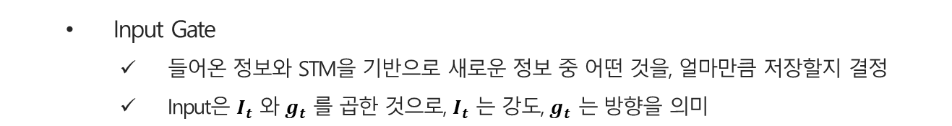
Long Short Term Memory
LSTM의 기본적인 구조
Input Gate
들어온 정보와 STM을 기반으로 새로운 정보 중 어떤 것을, 얼마만큼 저장할지 결정
Input은 $I_{t}$ 와 $g_{t}$ 를 곱한 것으로, $I_{t}$ 는 강도, $g_{t}$ 는 방향을 의미
$$Ignore factor I_{t}=σ\left(W_{I}\left(x_{t},h_{t−1}\right)\right)$$
$$Gain g_{t}=tanh(W_{g}\left(x_{t},h_{t−1}\right))$$
$$LTM : C_{t−1}$$
$$×$$
$$+$$
$$LTM : C_{t}$$
$$tanh$$
$$×$$
$$×$$
$$σ$$
$$σ$$
$$tanh$$
$$σ$$
$$STM : h_{t}$$
$$STM : h_{t−1}$$
$$x_{t}$$

Slide 8
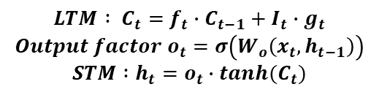
Long Short Term Memory
LSTM의 기본적인 구조
Output Gate, updated LTM & STM
LTM은 이전 스텝의 LTM에서 forget factor 를 곱한 후, 새로운 정보인 Input을 추가
Output factor 는 STM과 들어온 정보를 기반으로, LTM에서 어떤 정보를 활용할지 결정
STM은 갱신된 LTM에서 output factor를 고려한 값
$$LTM : C_{t}=f_{t}∙C_{t−1}+I_{t}∙g_{t}$$
$$Output factor o_{t}=σ\left(W_{o}\left(x_{t},h_{t−1}\right)\right)$$
$$STM :h_{t}=o_{t}∙tanh(C_{t})$$
$$LTM : C_{t−1}$$
$$×$$
$$+$$
$$LTM : C_{t}$$
$$tanh$$
$$×$$
$$×$$
$$σ$$
$$σ$$
$$tanh$$
$$σ$$
$$STM : h_{t}$$
$$STM : h_{t−1}$$
$$x_{t}$$

Slide 9







Gated Recurrent Unit
GRU의 기본적인 구조
Reset Gate
Reset factor 는 현재 메모리와 들어온 정보를 기반으로 어떤 정보를 메모리에서 지울지 결정
들어온 정보와 결합하여 임시 메모리를 만든다
$$Reset factor r_{t}=σ\left(W_{r}\left(x_{t},h_{t−1}\right)\right), h_{t}′=tanh\left(W_{h}\left(x_{t}, r_{t} ∗ h_{t−1}\right)\right)$$
$$h_{t−1}$$
$$σ$$
$$tanh$$
$$z_{t}$$
$$h_{t}$$
$$1−z_{t}$$
$$σ$$
$$x_{t}$$

Slide 10
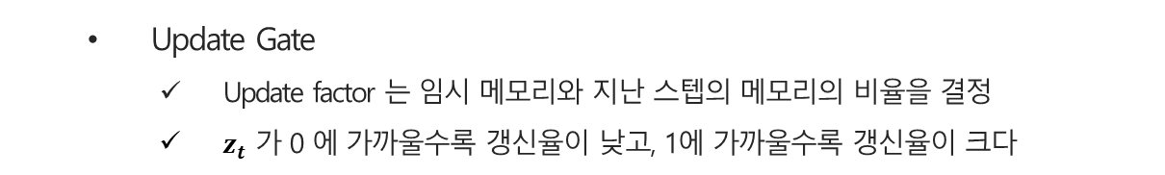
Gated Recurrent Unit
GRU의 기본적인 구조
Update Gate
Update factor 는 임시 메모리와 지난 스텝의 메모리의 비율을 결정
$z_{t}$ 가 0 에 가까울수록 갱신율이 낮고, 1에 가까울수록 갱신율이 크다
$$Update factor z_{t}=σ\left(W_{z}\left(x_{t},h_{t−1}\right)\right),$$
$$h_{t} =\left(1−z_{t}\right)∙h_{t−1}+z_{t}∙h_{t}′$$
$$h_{t−1}$$
$$σ$$
$$tanh$$
$$z_{t}$$
$$h_{t}$$
$$1−z_{t}$$
$$σ$$
$$x_{t}$$

